Slide 1
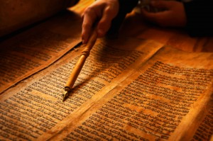
Leadership from Scripture
Larry Blackmer, EdD
North American Division

Slide 2
54 verses
Genesis through the New Testament
Advise, admonition, goals, demands

Slide 3
Leadership Traits
God has blessed you with:
Talents
Wisdom
Understanding
Temperament
Faith
Patience
Insight

Slide 4
Take a Sheet of Paper
Draw line down the middle
On the left, What has God blessed you with?
On the Right, What do you
and God need to work on?
God’s Blessings
What God needs to do in me

Slide 5
Phil. 2:3
³ Do nothing from selfish ambition or conceit, but in humility count others more significant than yourselves.
Humility

Slide 6
Matthew 20: 25-28
²⁵ But Jesus called them to him and said, “You know that the rulers of the Gentiles lord it over them, and their great ones exercise authority over them. ²⁶ It shall not be so among you. But whoever would be great among you must be your servant, ²⁷ and whoever would be first among you must be your slave, ²⁸ even as the Son of Man came not to be served but to serve, and to give his life as a ransom for many.”
Servant leadership

Slide 7
Romans 12:9-13
Let love be genuine. Abhor what is evil; hold fast to what is good. ¹⁰ Love one another with brotherly affection. Outdo one another in showing honor. ¹¹ Do not be slothful in zeal, be fervent in spirit, serve the Lord. ¹² Rejoice in hope, be patient in tribulation, be constant in prayer. ¹³ Contribute to the needs of the saints and seek to show hospitality.
True one anothering Rejoice in Hope Show hospitality

Slide 8
I Timothy 3: 1-7
3 The saying is trustworthy: If anyone aspires to the office of overseer, he desires a noble task. ² Therefore an overseer must be above reproach, the husband of one wife, sober-minded, self-controlled, respectable, hospitable, able to teach, ³ not a drunkard, not violent but gentle, not quarrelsome, not a lover of money. ⁴ He must manage his own household well, with all dignity keeping his children submissive, ⁵ for if someone does not know how to manage his own household, how will he care for God's church? ⁶ He must not be a recent convert, or he may become puffed up with conceit and fall into the condemnation of the devil. ⁷ Moreover, he must be well thought of by outsiders, so that he may not fall into disgrace, into a snare of the devil.
Above reproach
Manage their household
Well thought of by outsiders

Slide 9
Proverbs 3 5-10
¹ My son, do not forget my teaching, but let your heart keep my commandments, ² for length of days and years of life and peace they will add to you. ³ Let not steadfast love and faithfulness forsake you; bind them around your neck; write them on the tablet of your heart. ⁴ So you will find favor and good success in the sight of God and man. ⁵ Trust in the Lord with all your heart, and do not lean on your own understanding. ⁶ In all your ways acknowledge him, and he will make straight your paths. ⁷ Be not wise in your own eyes; fear the Lord, and turn away from evil. ⁸ It will be healing to your flesh and refreshment to your bones. ⁹ Honor the Lord with your wealth and with the first fruits of all your produce; ¹⁰ then your barns will be filled with plenty, and your vats will be bursting with wine.
Remember
Be faithful
Trust in the Lord
Acknowledge Him
Not wise in your eyes
Fear the Lord

Slide 10
2 Chronicles 1: 10-12
¹⁰ Give me now wisdom and knowledge to go out and come in before this people, for who can govern this people of yours, which is so great?” ¹¹ God answered Solomon, “Because this was in your heart, and you have not asked for possessions, wealth, honor, or the life of those who hate you, and have not even asked for long life, but have asked for wisdom and knowledge for yourself that you may govern my people over whom I have made you king, ¹² wisdom and knowledge are granted to you. I will also give you riches, possessions, and honor, such as none of the kings had who were before you, and none after you shall have the like.”
Wisdom and knowledge

Slide 11
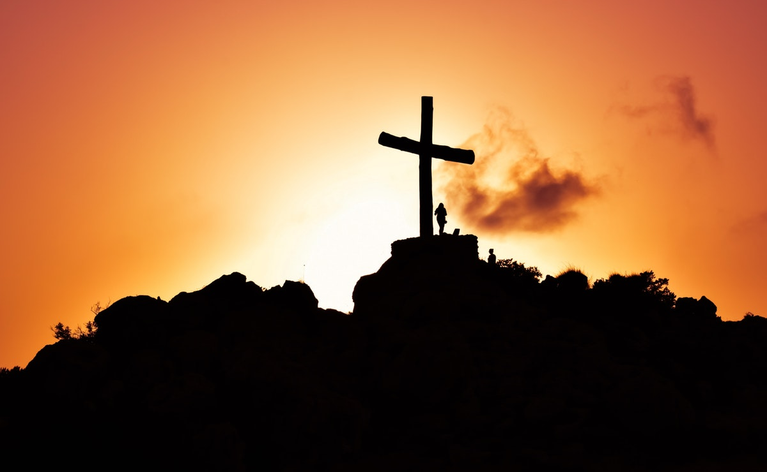
James 1: 5-6
⁵ If any of you lacks wisdom, let him ask God, who gives generously to all without reproach, and it will be given him. ⁶ But let him ask in faith, with no doubting, for the one who doubts is like a wave of the sea that is driven and tossed by the wind.
Faith

Slide 12
1 Peter 5: 3
³ not domineering over those in your charge, but being examples to the flock.
Be an example

Slide 13
Philippians 2: 4
⁴ Let each of you look not only to his own interests, but also to the interests of others.
Look to the interest of others

Slide 14
1 Peter 5: 2-5
² shepherd the flock of God that is among you, exercising oversight, not under compulsion, but willingly, as God would have you; not for shameful gain, but eagerly; ³ not domineering over those in your charge, but being examples to the flock. ⁴ And when the chief Shepherd appears, you will receive the unfading crown of glory. ⁵ Likewise, you who are younger, be subject to the elders. Clothe yourselves, all of you, with humility toward one another, for “God opposes the proud but gives grace to the humble.”
Lead gently

Slide 15
Hebrews 13: 17
¹⁷ Obey your leaders and submit to them, for they are keeping watch over your souls, as those who will have to give an account. Let them do this with joy and not with groaning, for that would be of no advantage to you.
Learn to follow

Slide 16
Proverbs 16: 9
The heart of man plans his way, but the Lord establishes his steps.
Have vision, but allow the Lord to lead

Slide 17
Isaiah 33: 15-16
15He who walks righteously and speaks uprightly, who despises the gain of oppressions, who shakes his hands, lest they hold a bribe, who stops his ears from hearing of bloodshed and shuts his eyes from looking on evil, ¹⁶ he will dwell on the heights; his place of defense will be the fortresses of rocks; his bread will be given him; his water will be sure.
Character above gain

Slide 18
Proverbs 8: 1-11
Use Common Sense
Be open and truthful
¹Does not wisdom call? Does not understanding raise her voice? ² On the heights beside the way, at the crossroads she takes her stand; ³ beside the gates in front of the town, at the entrance of the portals she cries aloud: ⁴ “To you, O men, I call, and my cry is to the children of man. ⁵ O simple ones, learn prudence; O fools, learn sense. ⁶ Hear, for I will speak noble things, and from my lips will come what is right, ⁷ for my mouth will utter truth; wickedness is an abomination to my lips. ⁸ All the words of my mouth are righteous; there is nothing twisted or crooked in them. ⁹ They are all straight to him who understands, and right to those who find knowledge. ¹⁰ Take my instruction instead of silver, and knowledge rather than choice gold, ¹¹ for wisdom is better than jewels, and all that you may desire cannot compare with her.

Slide 19
Proverbs 8: 11-21
¹² “I, wisdom, dwell with prudence, and I find knowledge and discretion. ¹³ The fear of the Lord is hatred of evil. Pride and arrogance and the way of evil and perverted speech I hate. ¹⁴ I have counsel and sound wisdom; I have insight; I have strength. ¹⁵ By me kings reign, and rulers decree what is just; ¹⁶ by me princes' rule, and nobles, all who govern justly. ¹⁷ I love those who love me, and those who seek me diligently find me. ¹⁸ Riches and honor are with me, enduring wealth and righteousness. ¹⁹ My fruit is better than gold, even fine gold, and my yield than choice silver. ²⁰ I walk in the way of righteousness, in the paths of justice, ²¹ granting an inheritance to those who love me, and filling their treasuries.
Love righteousness and justice

Slide 20
Proverbs 8:22-31
²² “The Lord possessed me at the beginning of his work, the first of his acts of old. ²³ Ages ago I was set up, at the first, before the beginning of the earth. ²⁴ When there were no depths I was brought forth, when there were no springs abounding with water. ²⁵ Before the mountains had been shaped, before the hills, I was brought forth, ²⁶ before he had made the earth with its fields, or the first of the dust of the world. ²⁷ When he established the heavens, I was there; when he drew a circle on the face of the deep, ²⁸ when he made firm the skies above, when he established the fountains of the deep, ²⁹ when he assigned to the sea its limit, so that the waters might not transgress his command, when he marked out the foundations of the earth, ³⁰ then I was beside him, like a master workman, and I was daily his delight, rejoicing before him always, ³¹ rejoicing in his inhabited world and delighting in the children of man.
Acknowledge who God is

Slide 21
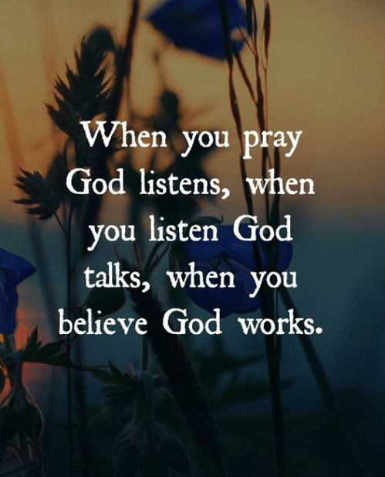
Proverbs 8: 32-36
³² “And now, O sons, listen to me: blessed are those who keep my ways. ³³ Hear instruction and be wise, and do not neglect it. ³⁴ Blessed is the one who listens to me, watching daily at my gates, waiting beside my doors. ³⁵ For whoever finds me finds life and obtains favor from the Lord, ³⁶ but he who fails to find me injures himself; all who hate me love death.”
Pray and listen

Slide 22
Traits Given in Scripture,
Lead gently
Learn to follow
Have vision, but allow the Lord to lead
Character above gain
Love righteousness and justice
Acknowledge who God is
Pray and listen
Humility
Servant leadership
True one anothering
Rejoice in Hope
Show hospitality
Wisdom and knowledge
Faith
Be an example
Look to the interest of others
38 more in scripture!

Slide 23
Comments?

